Slide 1
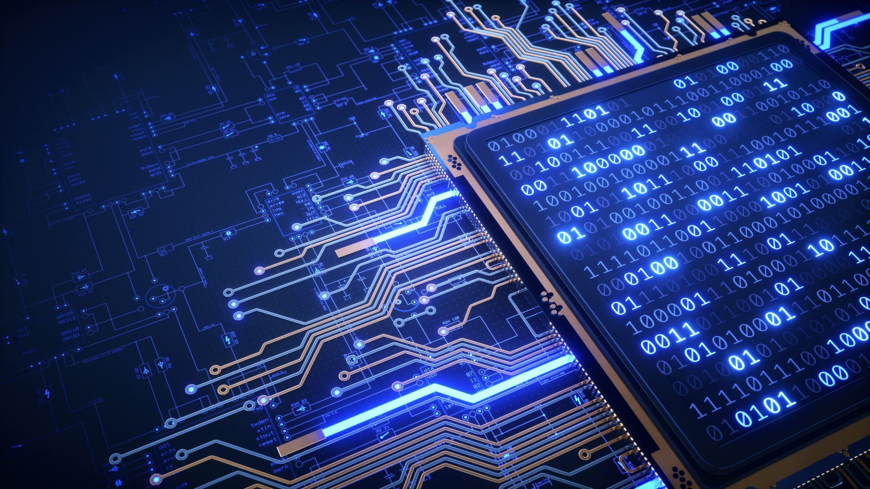
Network Security
CS-411

Slide 2
Class & Office Hours
Class Hours:
Monday 12:30 PM – 02:00 PM
Tuesday 12:30 PM – 02:00 PM
Office Hours:
Monday & Wednesday 11:00 AM – 12:00 PM

Slide 3
About Me
Mashal Khan
BS Computer Systems Engineering (UET Peshawar)
MS Information Security (NUST Islamabad)
Email: mashal.khan@nu.edu.pk

Slide 4
Books and Relevant Content
Cryptography and Network security by William Stallings
Cryptography and Network security by Behrouz A Forouzan
Network Security Fundamentals by Mark Ciampa
Certified Ethical Hacker (CEH) Foundation Guide by Sagar Ajay Rahalkar
Reading materials and Articles
Reference Slide at the end of every lecture to make your life easier ☺

Slide 5
Evaluations
Assessment | Weightage (%age)
Assignments / Case Studies | 10
Quizzes | 10
Project | 10
Sessional 1 | 15
Sessional 2 | 15
Finals | 40

Slide 6
What do you think about Network Security?
What is your motivation/objective to be in this class?
What are your expectations from this course?
Ever heard about any attacks on networks or any cyber attack?
Is Network security a concern/Important?
What should we consider while securing a system or network?

Slide 7
In this course we will study
Information Security
Application of Security
Major concerns and Attacks
Cryptography and related Arithmetics
Basics of Computer Networks
Network Security
Research areas
Relevant tools

Slide 8
Today’s Lecture
Intro to Information Security
Basic Terminologies
Laws and Legislations
NSA, NIST, OWASP, ISO, CVE
Security Attacks,
Security Services and
Security Mechanisms

Slide 9
Computer Security
The NIST Computer Security Handbook [NIST95] defines the term computer security as follows:
Computer Security: The protection afforded to an automated information system in order to attain the applicable objectives of preserving the integrity, availability, and confidentiality of information system resources (includes hardware, software, firmware, information/data, and telecommunications).

Slide 10
Information Security
Information security, sometimes shortened to infosec, is the practice of protecting information by mitigating information risks. It is part of information risk management.
It typically involves preventing or at least reducing the probability of unauthorized/inappropriate access to data, or the unlawful use, disclosure, disruption, deletion, corruption, modification, inspection, recording or devaluation of information.

Slide 11
Key Terminologies
Vulnerability
Exploit
Threat
Risk
Asset
White hat, Blact Hat, and Gray Hat Hacker
Sand Box
Honey pot
Encryption/Decryption
Malware

Slide 12
Laws and Legislations
Controlled Unclassified Information (CUI)
Digital Millennium Copyright Act (DMCA) and Higher Education Opportunity Act (HEOA)
Export Control (ITAR/EAR/OFAC)
Family Educational Rights and Privacy Act (FERPA)
Federal Information Security Management Act (FISMA)
General Data Protection Regulation (GDPR)
Gramm-Leach-Bliley Act (GLBA)
Health Insurance Portability and Accountability Act (HIPAA)
Payment Card Industry Data Security Standard (PCI DSS)
Protection of Human Subjects (Common Rule)
Red Flags Rule for Identity Theft Prevention
Social Security Number Privacy Act

Slide 13
Security Organizations and Databases
NSA: National Security Agency USA
National Institute of Standards and Technology NIST
International Organization for Standardization ISO
Open Web Application Security Project OWASP
Common Vulnerabilities and Exposures CVE
Notes:
ISO (International Organization for Standardization) is an independent, non-governmental, international organization that develops standards to ensure the quality, safety, and efficiency of products, services, and systems. ... ISO standards are in place to ensure consistency.
The Open Web Application Security Project is an online community that produces freely-available articles, methodologies, documentation, tools, and technologies in the field of web application security.

Slide 14
Objectives
Confidentiality
Integrity
Availability
Authentication
Authorization
Access Control

Slide 15

history

Slide 16
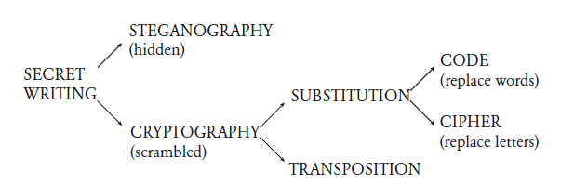
Secret Writing

Slide 17
Steganography
In Greek
Steganos = covered
Graphein = to write
Steganography is about hiding messages
Historically, secret messages were often hidden (or memorized)
Today, steganography is used primarily to protect digital rights

Slide 18
History of Steganography (Physically Hiding)
Runners were memorizing messages
Sometimes killed after delivering the message
Demaratus tells Athens of Persia’s attack plans
Writes the secret message on a tablet, and covers it with wax
Greek Histaiaeus encouraged Aristagoras of Miletus to revolt against the Persian King.
Writes message on the shaved head of the messenger, and sends him after his hair grew
Chinese silk balls
Message is written on silk, turned into wax-covered ball that was swallowed by the messenger…
Invisible ink-jet technology
Ink that is too small for human eye

Slide 19
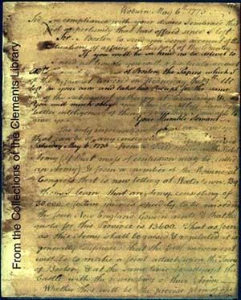

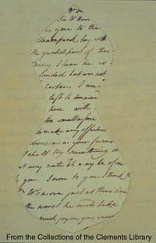
History of Steganography (cont.)
Invisible Ink
Certain organic fluids (milk, fruit juice) are transparent when dried but the deposit can be charred and is then visible
Romans used to write between the lines
A mixture of alum and vinegar may be used to write on hardboiled eggs, so that can only be read once shell is broken

Slide 20
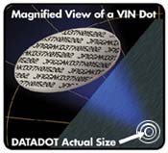
History of Steganography (cont.)
Microdots
WW2 Germany - documents shrunk to the size of a dot, and embedded within innocent letters
Inkjet dots, smaller than human eye can see
Microdots with barcode-like information
Notes:
Try to open notepad and type “Bush hid the facts”. Then save and reopen
Type Alt-Shift-2 in solitaire

Slide 21
Hiding a message within a text
An actual message from a German spy
read second letter in each word
“Apparently, neutral’s protest is thoroughly discounted and ignored. Isman hard hit. Blockade issue affect pretext for embargo on by products, ejecting suets and vegetable oils.”
“Pershing Sails from NY June 1”

Slide 22
Hiding a message within a text (more)
Shift some words by one point/pixel.
Shifted words (or their first letters) make the sentence
Use different fonts
Letter by letter or word by word (Francis Bacon Cipher)
Lexical steganography uses the redundancy of the English language
“I feel well” and “I feel fine” seem the same, but one may be used to encode “SOS”
Chaffing and winnowing
Riddle text with extra parts that the receiver will know how to remove (e.g., those that don’t “authenticate”)

Slide 23
Modern Steganography
Hiding one message within another (“container”)
Most containers are rich media
Images, audio, video are very redundant, can be tweaked without affecting human eye/ear
US argued that Bin Laden implanted instructions within taped interviews
Copyright notices embedded in digital art
Prove ownership
Serial number embedded to prevent replication
Seek infringements on the web using spiders
Digital cameras EXIF tags
Not secretive, but hidden from the eye
Embed info such as camera type, date, shutter speed, focal length,..
Similarly, possible to embed messages in invisible parts of html pages
Notes:
EXIF = Exchangeable Image File Format

Slide 24

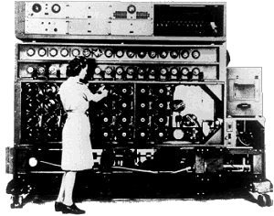


Example (Steganos) LSBs are used
Original Picture | Embedded Picture
With embedded picture | JPG version

Slide 25
Steganography (Summary)
Steganography is arguably weaker than cryptography because the information is revealed once the message is intercepted
On the other hand, an encrypted message that is not hidden may attract attention, and in some cases may itself incriminate the messenger
In any event, steganography can be used in conjunction with cryptography

Slide 26
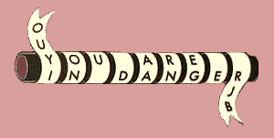
Cryptography
In Cryptography, the meaning of the message is hidden, not its existence
Kryptos = “hidden” in Greek
Historically, and also today, encryption involves
transposition of letters
Sparta’s scytale is first cryptographic device (5th Century BC)
Message written on a leather strip, which is then unwound to scramble the message
substitution
Hebrew ATBASH (אתבש)
Cipher – replace letters
Code – replace words

Slide 27
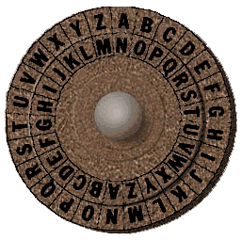
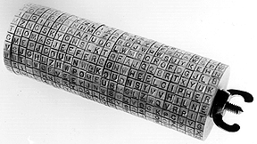
Monoalphabetic Ciphers
Caesar Shift Cipher
Each letter substituted by shifting n=3 places
E X A M P L E
H A D P S O H
Jefferson wheel implementation
Set the message across the wheels
Select another line (in random) as cipher
Notes:
Emphasize weakness of a cipher with a small number of possibilities
In theory, the general monoalphabetic cipher has a larger key space than DES

Slide 28
Breaking Monoalphabetic Ciphers
The Arabs broke monoalphabetic substitution using frequency analysis
In English (Source: Beker & Piper)
Thus, letters ciphering e, t, and a are easily discovered
Subsequently can look for the rest of the letters and letter pairs
a | 8.2% | j | 0.2 | s | 6.3
b | 1.5 | k | 0.8 | t | 9.1
c | 2.8 | l | 4.0 | u | 2.8
d | 4.3 | m | 2.4 | v | 1.0
e | 12.7 | n | 6.7 | w | 2.4
f | 2.2 | o | 7.5 | x | 0.2
g | 2.0 | p | 1.9 | y | 2.0
h | 6.1 | q | 0.1 | z | 0.1
i | 7.0 | r | 6.0

Slide 29
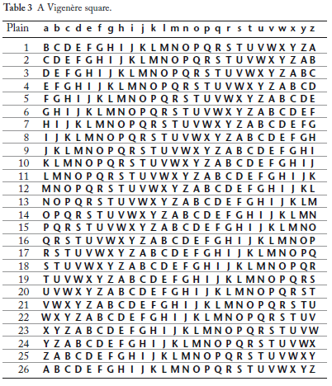
Vigenere Polyalphabetic Cipher
Vigenere’s polyalphabetic cipher (19th century) generalizes Caesar’s shift cipher
Use keyword to select encrypting rows
The Vigenere cipher is not amenable to simple frequency analysis
Actually invented earlier (16th century)
Called “The Unbreakable Cipher”
Vigenere Tableau
Notes:
demonstrate

Slide 30

Babbage breaks Vigenere Cipher
Babbage broke Vigenere’s Cipher (1854, Crimean war)
Stage 1: Discover key length
Look for repeated sequences, and measure their distance
The key length is a factor of these distances
Stage 2: Identify the key itself
Compare distributions for each of the key
letters with the standard distribution, to
identify the shift
Babbage could not publish his work
Similar techniques developed independently by Kasiski (a Prussian officer); Kerckhoff (French cryptographer)
Check out an applet that breaks Vigenere: http://math.ucsd.edu/~crypto/java/EARLYCIPHERS/Vigenere.html
Notes:
Demonstrate how this works

Slide 31
Summary of Historical Crypto
Encryption Algorithms and Keys
Substitution : letters (bits), words
Transposition
Decryption Algorithms
Reversed process
Require knowledge of the algorithm and the key
Cryptanalysis
Identify algorithm
Obtain as many plaintext-ciphertext pairs
Use systematicity (patterns)
Use hints (cribs)

Slide 32
Modern History
Main source: Network Security Essentials / Stallings

Slide 33
Kerckhoffs Principles System + Keys Auguste Kerckhoffs, Journal of Military Science, 1883
The system must be substantially, if not mathematically, undecipherable;
The system must not require secrecy and can be stolen by the enemy without causing trouble;
It must be easy to communicate and remember the keys without requiring written notes, it must also be easy to change or modify the keys with different participants;
The system ought to be compatible with telegraph communication;
The system must be portable, and its use must not require more than one person;
Finally, regarding the circumstances in which such system is applied, it must be easy to use and must neither require stress of mind nor the knowledge of a long series of rules.

Slide 34
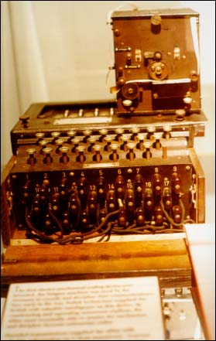
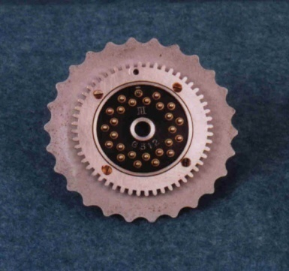
The German Enigma
Invented as a commercial machine (Scherbius), and failed
Electrical typewriter-like encryption machine
Each keystroke lights a letter
Performing substitutions
Letter-pairs are switched
Pulse goes through scramblers
Hits reflector and goes back
Original Enigma (M3) based on commercial version
swapped letter-pairs
3 rotating scramblers (26³ orientations)
scramblers can be configured in 6 (3!) ways
Later, up to 5 scramblers to choose from
Theoretical key space = a total of 10¹⁷ combinations
Used extensively by Germans in WW2
Notes:
Invented originally as a commercial machine, and failed
Navy admiral (Doenitz) instructed fortifying it with a fourth scrambler, of which three were selected
Show the combinatorial contribution of each part
Can download a simulator at http://w1tp.com/enigma

Slide 35
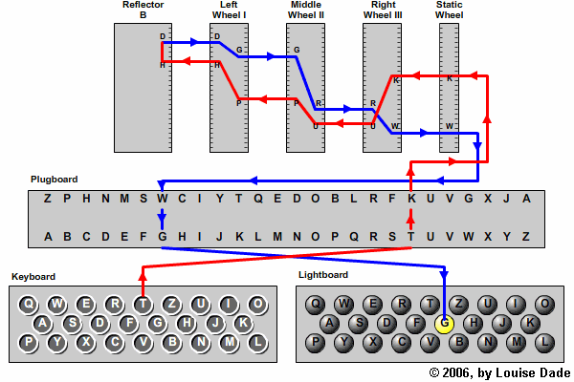

Slide 36
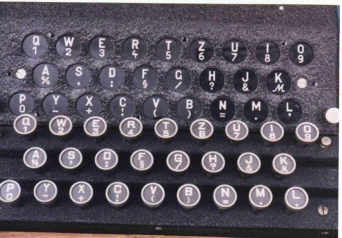
Poles Crack the Enigma
Polish obtained an Enigma from a German spy (1933)
Hans-Thilo Schmidt sold to French intelligence
Obtained information on its usage
daily code book indicated rotors and orientation
a different orientation key for each message (swapped keys)
Notes:
Hans Thilo-Schmidt worked for the German Cryptographic Office, and sold the Enigma to the French Intelligence

Slide 37
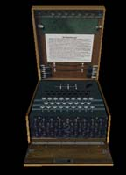
Poles Crack the Enigma
Rejewski’s algorithm to discover the day key
First, use catalog to identify the scrambler setting and orientation
Then, run the ciphertext through an Enigma and look at the text to identify swapped letter pairs using frequency analysis
Bombe machines were constructed to mechanize the search
Notes:
A one-ton machine that essentially stringed together 6 Enigmas (one for each ordering of the scramblers)

Slide 38
Computationally Secure Encryption
Encryption scheme is computationally secure if
The cost of breaking the cipher exceeds the value of the encrypted information; or
The time required to break the cipher exceeds the useful lifetime of the information
Most schemes that we will discuss are not unbreakable in principle, but are computationally secure
Rely on lack of knowledge of effective algorithms for certain hard problems, not on a proven inexistence of ones
E.g., factorization, discrete logarithms, or square roots mod p
Rely on very large key-space, impregnable to brute force

Slide 39
Computer Security
Computer security, also known as cyber security or IT security, is the protection of computer systems from the theft or damage to hardware/software/ information, as well as from disruption or misdirection of the services they provide.
Cryptography is the practice and study of techniques for ensuring secure communication.
National Institute of Standards and Technology (NIST) produces many standards and procedures for the security industry

Slide 40
Core Elements
Computation device
-PC, laptop, tablet, smartphone, watch, tv,…
Information
–The basic building block of all communications. This is what the attacker is after
Internet Security
–Protect against fraud and attacks on the internet
–Establishing trust between parties
–Ensuring secrecy of communications
–Protect against malicious entities, software and exploits
Communication Security
–prevention of unauthorized access to telecommunications traffic
–Intercepting traffic
–Service Interruption

Slide 41
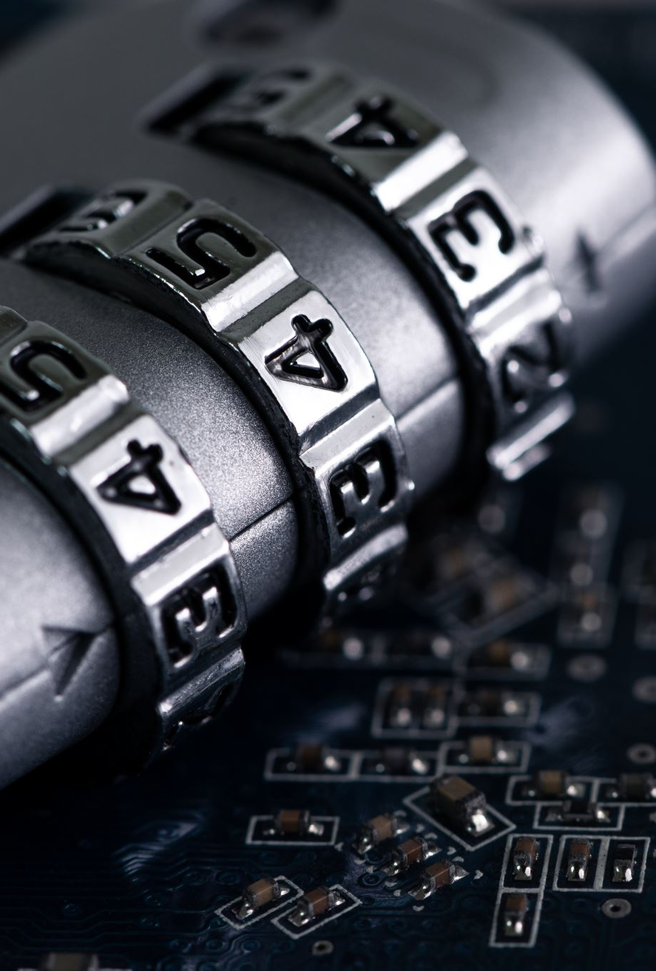
Threat vs Attack
Vulnerability is a weakness which allows an attacker to reduce a system’s security assurance.
–a system weakness or flaw,
–attacker access to the flaw,
–attacker capability to exploit
Threat -A potential for violation of security. Hence a threat is a possible danger that might exploit a vulnerability.
Attack -an intelligent act that is a deliberate attempt to evade security services and violate the security policy of a system.

Slide 42
Security Architecture
Consists of three elements
Security Attack- Any action that can cause a compromise
Security Service - A processing or communication service that enhances security. Security services are intended to counter security attacks, and they make use of one or more security mechanisms to provide the service.
Security Mechanism- A process designed to detect, prevent or recover from an attack.

Slide 43
Security Attacks
Passive Attacks
Passive attacks are in the nature of eavesdropping on, or monitoring of, transmissions. The goal of the opponent is to obtain information that is being transmitted.
Happens through traffic analysis, silent listening/eaves dropping, release of message content(by somebody else)
Active Attacks
Active attacks involve some modification of the data stream or the creation of a false stream. Generally, happens through masquerading, replay, modification of messages, and denial of service.

Slide 44
Active Attacks
Masquerading
Takesplacewhenoneentitypretendstobeadifferententity.Happensthroughdefeatingauthentication,obtainingprivilegesetc.
Replay
Capture a message and replay it later
Modification of messages
Messages are entirely or partially modified.
Denial of Service
Block services to cause unavailability of services. Particularly dangerous in internet systems like e-health systems.

Slide 45
Security Services
Three security goals that need to be addressed
Confidentiality
–Data Confidentiality
–Privacy
•Integrity
–Data integrity
–System Integrity
Availability

Slide 46

Confidentiality
Preserving authorized restrictions on information access and disclosure, including means for protecting personal privacy and proprietary information.
A loss of confidentiality is the unauthorized disclosure of information.

Slide 47
Integrity
Guarding against improper information modification or destruction.
A loss of integrity is the unauthorized modification or destruction of information.
Ideally should protect against intentional and unintentional modification.
No modification, no insertion, no deletion,no replay

Slide 48
Availability
Ensuring timely and reliable access to and use of information.
A loss of availability is the disruption of access to or use of information or an information system.
Particularly targets Denial of Service attacks

Slide 49
Other Goals
Authentication- verifying that users are who they say they are and that each input arriving at the system came from a trusted source.
Authorization- the function of specifying access rights/privileges to resources.
Nonrepudiation- is the assurance that a party cannot deny a particular action.

Slide 50

Security Mechanisms
Security mechanisms are used to implement security services.
Encipherment
Digital signature
Access Control mechanisms
Data Integrity mechanisms
Authentication Exchange

Slide 51
Today’s Task
Watch Movie “The imitation Game” .
Discuss the importance of Information Security with reference to the movie.
What did you learn?
What was the impact of cryptography on WW2?
Notes:
Window patches, software updates importance

Slide 52
References
Movie: The Imitation Game
https://en.wikipedia.org/wiki/Information_security
https://www.csoonline.com/article/3604334/csos-ultimate-guide-to-security-and-privacy-laws-regulations-and-compliance.html
https://safecomputing.umich.edu/protect-the-u/compliance/compliance-table
https://owasp.org/www-project-top-ten/
https://cve.mitre.org/

